Slide 1

The Business of Medicine
Insurance Challenges and Reform: Advocacy for Physicians and Patients
Presented by
April A. Bellard, MHA
Director of Payment Advocacy and Practice Management
Harris County Medical Society (HCMS)
Feb. 1, 2026

Slide 2
Disclaimer
The information provided on this presentation is for general informational purposes only and does not constitute legal advice.

Slide 3
Health Plan Types
The regulatory authority overseeing compliance with state and/or federal requirements varies by plan type. A thorough understanding of each plan type, its regulatory framework and related processes (e.g., contracting, credentialing, complaints, prior authorization), is essential.
Health plan payment rates, policies, administrative burdens, and barriers to patient care also significantly affect practice operations. Independent practices tend to experience these impacts more directly, while employed providers may feel them indirectly. Regardless of practice structure, all providers are affected by the health plans with which they contract.

Slide 4
Practice Settings
Each practice setting has unique advantages and challenges, but in all cases, insurance and health plan policies influence how medicine is practiced.
Employment
Group
Hospital
Academic
Health Plan
Independent Practice

Slide 5
Health Plan Types
Medicare (MCR) and Medicare Advantage Plans (MAPs)
Medicaid (MCD) and Managed Medicaid Plans (MCOs)
Commercial and Marketplace Plans
Other Governmental (VA, active and retired military, state and federal employer, etc.)

Slide 6
Traditional Medicare
Traditional, or Fee-for-Service (FFS), Medicare is regulated at the federal level by the Centers for Medicare & Medicaid Services (CMS).
Administrative services, including claims processing, enrollment, and other functions are handled regionally by Medicare Administrative Contractors (MACs), such as Novitas.
Physician complaints and inquiries are managed through CMS Regional Offices, ensuring oversight and support for providers participating in the program. There are 3 parts to Medicare - Part A (hospital/facility), Part B (physician services), and Part D (prescription drugs).

Slide 7
Traditional Medicare
Challenges:
Cumbersome administrative processes (eligibility, benefits, appeals, etc.)
Stringent National Correct Coding Initiative claim edits (PTP, MUE, N/A indicators, etc.)
Increasing prior authorization requirements
Unresponsive Regional Administrators (RACs) responsible for handling complaints/grievances and limited access to MAC representatives
Requires participation in Quality Payment Programs (QPP)
Low and declining reimbursement rates to cover costs
physician fee schedule subject to budget neutrality, sequestration, PAYGO, and QPP penalties
no adjustment for inflation
frequent payment cuts and budget neutrality adjustments

Slide 8
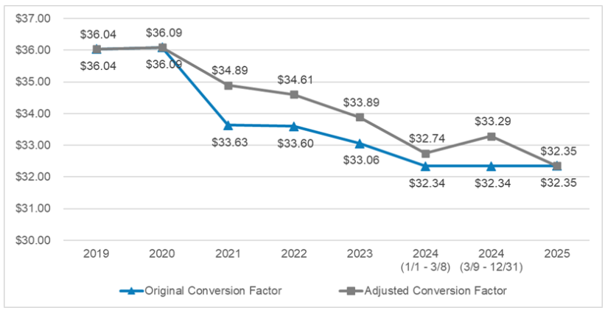
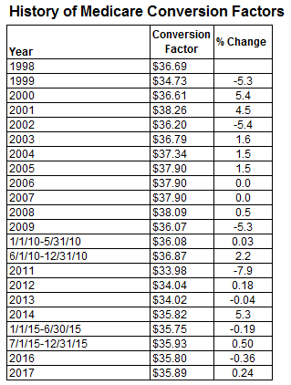
Conversion Factor (CF)

Slide 9
Traditional Medicare
Advocacy:
HCMS and the Texas Medical Association (TMA) are actively advocating for permanent Medicare payment reform to offset inflationary losses, including annual payment updates tied to the Medicare Economic Index (MEI) rather than the current RVU, GPCI, and conversion factor framework.
At the national level, the American Medical Association (AMA), with support from the Texas delegation, has adopted policies supporting comprehensive payment reform
HCMS, the TMA, and AMA are advocating for improvements and burden reduction in QPP programs.
These organizations are also working to reduce administrative burdens associated with the newly implemented WISeR model and its expanded prior authorization requirements.

Slide 10
Medicare Advantage Plans (MAPs)
Medicare Advantage Plans are offered by private insurers and combine Medicare Parts A, B, and D into a single plan. Although regulated by the Centers for Medicare & Medicaid Services (CMS), these plans function similarly to commercial insurance products. Medicare Advantage was intended to lower overall Medicare spending; however, it has not achieved this goal and is estimated to cost taxpayers approximately 20% more per enrollee than traditional Medicare.
Challenges:
Reimbursement rates tied to Medicare, often inadequate to cover costs and declining over time
Strict National Correct Coding Initiative (NCCI) edits, including PTP, MUE, and add-on code limitations
In-network referral and authorization requirements
Restricted formularies with tiers, step therapy, and prior authorization
Complex, time-consuming, and often ineffective appeals processes

Slide 11
Medicare Advantage Plans (MAPs)
Annual audits frequently resulting in significant payment recoupments
Limited or no access to provider representatives
Automatic downcoding of Evaluation and Management (E/M) services
Unresponsive Regional Administrators (RACs) responsible for complaint and grievance resolution
Extensive prior authorization requirements for radiology, high-cost services, and even generic medications
Between 3.5% and 13.6% prior authorization requests were denied in 2023 according to a KFF study.
More than 80% of those that were appealed were overturned indicating significant inappropriate, premature, or wrongful denials that restricted access to medically necessary care.

Slide 12
Medicare Advantage Plans (MAPs)
Advocacy:
Payment Reform - Medicare Payment Reform is needed to address persistently low reimbursement rates within Medicare Advantage plans.
Automatic Downcoding of E/M Services –
In May 2024, HCMS submitted Resolution 403 to the TMA House of Delegates requesting action to prohibit automatic downcoding. The resolution advanced to the June 2024 AMA HOD as Resolution 714, where it was adopted. As a result, the AMA updated Policy D-320.972 to reflect this position.
HCMS continues to collaborate with the AMA to pursue regulatory relief from automatic downcoding practices. In June 2025, the AMA released model state legislation, the Transparency in Downcoding Act, to support state-level advocacy. The AMA is also actively pursuing federal legislative and regulatory action to prohibit automatic downcoding in self-insured ERISA plans.

Slide 13
Medicaid and Medicaid Managed Care
Medicaid is a joint state and federal program serving individuals and families who meet income eligibility requirements regulated by the Texas Health and Human Services with some federal oversight by the CMS. It is administered by the Texas Medicaid & Healthcare Partnership (TMHP).
Texas Medicaid programs include STAR, STAR+PLUS, STAR Health, and STAR Kids, which primarily provide services through Managed Care Organizations (MCOs) with limited provider networks who often offer supplemental benefits such as dental and vision care.
The Children’s Health Insurance Program (CHIP) provides low-cost coverage for children ages 0–18 in families who do not qualify for Medicaid but cannot afford private insurance. CHIP is also administered through private MCOs.

Slide 14
Medicaid and Medicaid Managed Care
Challenges:
Complex and burdensome provider enrollment process
Revalidation required every 3 years
Annual audits frequently resulting in payment recoupments
State mandate requiring 50% of physician contracts to be value-based, with 25% involving downside financial risk (PIP)
Reimbursement rates significantly below Medicare and insufficient to cover practice costs
Example: Mid-level office visit 99213
MCR: $96.33 MCD: $33.95

Slide 15
Medicaid and Medicaid Managed Care
Advocacy:
2023 Payment Rates: TMA successfully secured a 6% payment increase for labor and delivery services and extended postpartum coverage from 6 months to 12 months.
2025–2026: TMA continues collaboration with HCMS and Medicaid to ensure alignment with MACPAC recommendations to Congress on Medicaid and CHIP policy.
2024–2025 Enrollment Issues: HCMS obtained deadline extensions and retroactive effective dates from HHS to address TMHP enrollment system (PEMS) failures. These efforts led to passage of SB 1266, requiring TMHP to improve enrollment and revalidation support for physicians.
2024–2025 PIP Program Oversight: HCMS filed multiple complaints with HHS regarding underpayments, attribution errors, and reporting deficiencies. HHS will revise contract language in the next contracting cycle to address these issues.

Slide 16
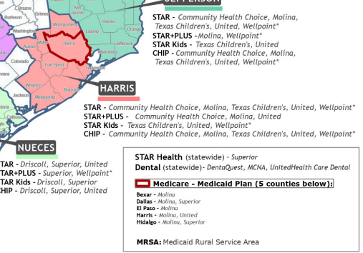
Harris County MCOs

Slide 17
Commercial Plans
Commercial plans include a variety of group and individual products, each overseen by different regulatory authorities:
Group plans:
Self-insured – federally regulated under ERISA
Fully-insured – State regulated under the Texas Department of Insurance (TDI)
Marketplace (ACA/Obamacare) - State regulated under the Texas Department of Insurance (TDI)

Slide 18
Commercial Plans
Most working-aged individuals and their dependents are covered by one of the five largest commercial insurers. These insurers typically offer a range of products including:
Employer sponsored fully-Insured Plans
Employer sponsored self-Insured/ERISA Plans
Medicare Advantage Plans
Medicaid Managed Care Plans
Individual/Marketplace Plans
The five major market insurers:
Aetna
BCBS/Anthem
Cigna
Humana
United Healthcare

Slide 19
Commercial Plans Fully-Insured
Fully-insured Plans:
These are traditional employer-sponsored plans where the employer pays a fixed premium to an insurer, and the insurer takes on all the financial risk, claims payment, administration, and regulatory compliance (similar to home or auto insurance).
Represents 33%-37% of the commercial market
Often subject to large annual premium increases
Regulated by the Texas Department of Insurance (TDI)
Subject to Texas Prompt Pay Regulations
“TDI” or “DOI” printed on the patient’s ID card

Slide 20
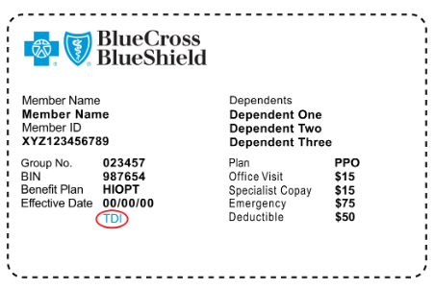
Commercial Plans Fully-Insured

Slide 21
Commercial Plans Self-Insured
Self-insured Plans:
The employer acts as the insurer, assuming financial risk for claims from company funds, often with stop-loss coverage for catastrophic claims. Administration is typically handled by a third-party administrator (TPA) or Management Services Organization (MSO). These plans are not insurance products.
Represent 63%-67% of the commercial market
Not subject to large annual premium increases
Regulated under federal ERISA, not the Texas Department of Insurance (TDI)
Not subject to Texas Prompt Pay regulations
“TDI” or “DOI” does not appear on the patient’s ID card
Most if not all five major commercial insurers are now primarily in the business of administering self-insured plans for employers.

Slide 22
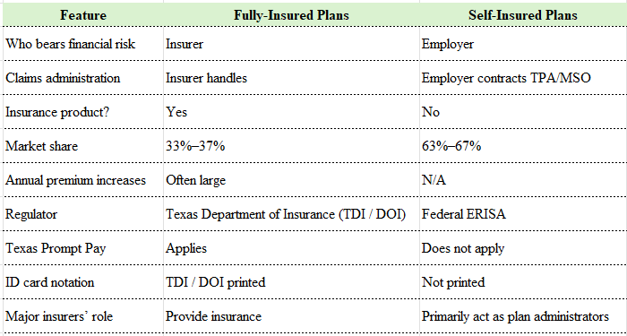
Fully-Insured vs. Self-Insured

Slide 23
Commercial Plans
Challenges:
Inconsistent and opaque policies: Coding rules, billing requirements, and claim edits vary widely
Burdensome prior authorization requirements
Limited or no access to provider representatives
Claims representatives often lack knowledge of billing, coding, or denial resolution
Reconsideration and appeals frequently unsuccessful
Limited complaint mechanisms:
ERISA (self-insured) – no effective physician grievance process
TDI (fully-insured) – often ineffective for physician complaints
Automatic downcoding of E/M services

Slide 24
Commercial Plans
Advocacy:
Prior Authorization Reform
Gold Card Reform (Texas) - In 2024, HCMS submitted Resolution 401 to the TMA House of Delegates (HOD) to strengthen Texas’ Gold Card regulations. This effort led to the passage of HB 3812, amending and expanding the original 2021 legislation.
2021: HCMS and TMA passed HB 3459 to reduce burdensome prior authorizations
Fewer than 4% of physicians qualified
2024: HCMS submitted Resolution 401 to push for insurer transparency in gold-carding
2025: Additional legislation refined and expanded gold-carding protections
Automatic Downcoding (see slide 12)
Retro-terminations: In 2025 HCMS submitted Resolution 406 to prohibit recoupments related to retro-termination of patient coverage; adopted at TMA HOD.
ERISA & Prompt Pay Reform
2025: HCMS began discussions with AMA and other state societies to pursue comprehensive ERISA reform
2026: HCMS submitted Resolution 5 requesting AMA develop regulatory language for prompt pay protections, modeled after Texas Prompt Pay laws.

Slide 25
Contact Information
April A. Bellard, MHA
Director of Payment Advocacy and Practice Management
Harris County Medical Society
1515 Hermann Dr., #203
Houston, TX 77004
Phone: 713-524-4267 ext. 203
Email: April_Bellard@hcms.org

