Slide 1
Evaluation & Management Coding and Documentation
Harris County Medical Society
April A. Bellard, MHA
Director of Payment Advocacy and Practice Management

Slide 2
2021 and 2023 E/M Revisions
On January 1, 2021, the CPT Editorial Panel revisions to the Evaluation and Management (E/M) office visit codes (99201-99215) code descriptors and documentation standards went into effect.
The CPT Editorial Panel approved additional revisions to provide continuity across all the E/M sections allowing for the revisions implemented in 2021 revisions to extend to other E/M sections effective Jan. 1, 2023. CMS finalized a policy to adopt most of these revisions in the CY 2023 Medicare Physician Fee Schedule Final Rule, effective January 1, 2023. Variations were made for prolonged services, times associated with certain codes, etc.

Slide 3
2021 Summary of Revisions 99201-99215
1. Eliminate history and physical as elements for code selection: These elements are no longer needed to be considered/counted in selecting the appropriate code level for codes 99202-99215. Providers should perform a “medically appropriate history and/or examination”
2. Allow physicians to choose documentation based on Medical Decision Making (MDM) or Total Time:
MDM: The Workgroup did not materially change the three current MDM sub-components but did provide extensive edits to the elements for code selection and revised/created numerous clarifying definitions in the E/M guidelines.
Time: The definition of time is now a minimum time, not typical time, and represents total physician/qualified health care professional (QHP) time on the date of service. These definitions only apply when code selection is primarily based on time and not MDM.
3. Modifications to the criteria for MDM:
Removed ambiguous terms (e.g. “mild”) and defined previously ambiguous concepts (e.g. “acute or chronic illness with systemic symptoms”).
Defined important terms, such as “independent historian.”
Re-defined the data element to move away from simply adding up tasks to focusing on tasks that affect the management of the patient (e.g. independent interpretation of a test performed by another provider and/or discussion of test interpretation with an external physician/QHP).
4. Deletion of CPT code 99201: The Panel agreed to eliminate 99201 as 99201 and 99202 are both straightforward MDM and only differentiated by history and exam elements, which are no longer used for code selection.
5. Creation of a shorter prolonged services code: The Panel created a shorter prolonged services code that would capture physician/QHP time in 15-minute increments. This code would only be reported with 99205 and 99215 and be used when time was the primary basis for code selection.

Slide 4
2021 Revisions - Prolonged Services
Several prolonged services codes were created/revised, some with a shorter time increment, that would capture physician/QHP time beyond the time of the highest-level E/M office or other outpatient visit (99205 or 99215). Most of these are add-on codes designated with a “+” and must be billed with a primary CPT code and are only to be used when time is the basis for code selection. However, there are some exceptions.
99415, 99416 - Prolonged Clinical Staff Services With Physician or Other Qualified Health Care Professional Supervision (in the office or other outpatient setting; the physician/QHP must be present to supervise the clinical staff)
99417 - Prolonged Service With or Without Direct Patient Contact on the Date of an Office or Other Outpatient Service (beyond the total time of the primary procedure which has been selected using total time); each 15 minutes. Time spent performing separately reported services other than the E/M service is not counted toward the time to report 99205, 99215 and prolonged services time.
G2212 - (for Medicare/MAPs) the maximum time requirement differs from the CPT definition use when the maximum time for the level 5 visit is exceeded by at least 15 minutes on the date of service; see slides 28-29.
G2211 - (for Medicare/MAPs;) – Eff. Jan. 1, 2024. Visit complexity inherent to evaluation and management associated with medical care services that serve as the continuing focal point for all needed health care services and/or with medical care services that are part of ongoing care related to a patient’s single, serious condition or a complex condition. (Add-on code, list separately in addition to office/outpatient evaluation and management visit, new or established, do not bill when E/M appended with mod. 25).
Do not use the following prolonged service codes with 99202-99215:
99354-99357 - Prolonged Service With Direct Patient Contact (which includes non-face-to-face time on the patient’s floor/unit, does not have to be continuous time). Deleted in the 2023 revisions.
99358-99359 - Prolonged service without direct patient contact for dates other than the date of an encounter (in the inpatient, observation, or outpatient settings, or additional floor/unit time in the hospital/nursing facility) (do not use for Medicare). May be used during the same date of an evaluation and management service, except for 99202–99215. Use 99417 for same date encounters with 99202–99215.

Slide 5
Time - Documentation and Code Selection
The rules regarding code selection for Office and Other Outpatient E/M Services have been revised, as have some of the times associated with them. Certain categories of time-based E/M codes that do not have levels of services based on MDM (eg, Critical Care Services) in the E/M section use time differently. It is important to review the instructions for each category. For codes where time is not a descriptive element (ER Dept.), use MDM for code selection.
For office visit E/M codes (99202-99215), the 2021 rules eliminated the requirement that counseling and/or coordination of care dominate (greater than 50% of the time) the encounter.
The time defined in the service descriptors is used for selecting the appropriate level of services. The E/M services for which these guidelines apply require a face-to-face encounter with the physician or other qualified health care professional (QHP) and the patient and/or family/caregiver. The time that is counted is all the time on the date of the encounter only, including time spent before and after the encounter regardless of the location of the physician or other QHP (eg, whether on or off the inpatient unit or in or out of the outpatient office). It does not include any time spent in the performance of other separately reported services.

Slide 6
Time cont.
Physician and other qualified health care professional (QHP) time includes the following activities (only the reporting clinician’s time can be counted).
▪ preparing to see the patient (review of tests, etc.)
▪ obtaining and/or reviewing separately obtained history
▪ performing a medically appropriate examination and/or evaluation
▪ counseling and educating the patient/family/caregiver
▪ ordering medications, tests, or procedures
▪ referring and communicating with other health care professionals (when not separately reported)
▪ documenting clinical information in the electronic or other health record
▪ independently interpreting results (not separately reported) and communicating results to the patient/family/caregiver
▪ care coordination (not separately reported)

Slide 7
Time cont.
Document and count the following:
Include both face to face and non face to face time on the date of the encounter only.
Include only the reporting clinician’s time. Do not include time spent by clinical staff.
Document assessment and plan.
Document actual time spent precisely. Do not document a time range.
Do not include time for services billed separately.
Only distinct time should be summed for shared or split visits (i.e., when two or more individuals jointly meet with or discuss the patient, only the time of one individual should be counted)

Slide 8
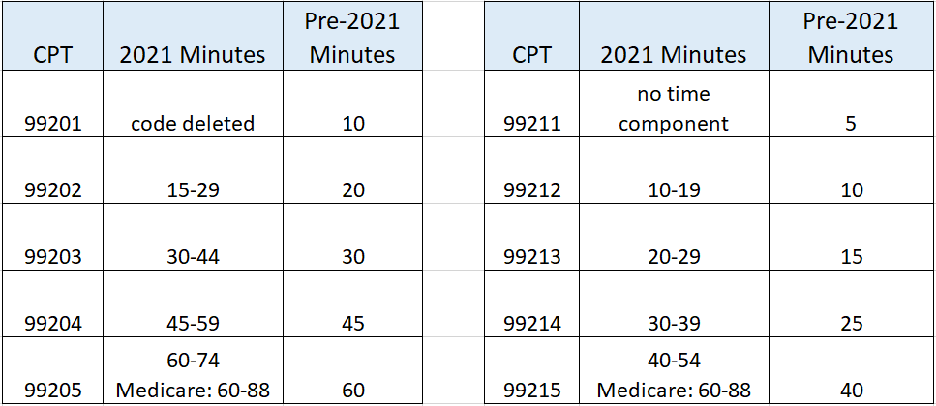
Time cont.

Slide 9
Time - Prolonged Services cont.
99415-99416 - Prolonged Clinical Staff Services With Physician or Other Qualified Health Care Professional Supervision
+99415 - Prolonged clinical staff service (the service beyond the typical service time) during an evaluation and management service in the office or outpatient setting, direct patient contact with physician supervision; first hour (list separately in addition to code for outpatient Evaluation and Management service) (Use 99415 in conjunction with 99202, 99203, 99204, 99205, 99211, 99212, 99213, 99214, 99215) (Do not report 99415 in conjunction with 99354, 99355, 99417)
+99416 - Each additional 30 minutes (list separately in addition to code for prolonged service) (Use 99416 in conjunction with 99415) (Do not report 99416 in conjunction with 99354, 99355, 99417)
Codes 99415 and 99416 are used to report the total duration of face-to-face time spent by clinical staff on a given date in the office or other outpatient setting, even if the time spent on that date is not continuous. Time spent performing separately reported services other than the E/M service is not counted toward the prolonged services time. Code 99415 should be used only once per date.
For prolonged services by the physician or other qualified health care professional, see 99354, 99355 (Deleted in the 2023 revisions), 99417. Do not report 99415, 99416 with 99354, 99355, 99417.)

Slide 10
Time - Prolonged Services cont.
99417 - Prolonged Service With or Without Direct Patient Contact on the Date of an Office or Other Outpatient Service
Prolonged office or other outpatient evaluation and management service(s) (beyond the total time of the primary procedure which has been selected using total time), requiring total time with or without direct patient contact beyond the usual service, on the date of the primary service; each 15 minutes (List separately in addition to codes 99205, 99215 for office or other outpatient Evaluation and Management services). Code 99417 is only used when the office or other outpatient service has been selected using time alone as the basis and only after the total time of the highest-level service (ie, 99205 or 99215) has been exceeded. Time spent performing separately reported services other than the E/M service is not counted toward the time to report 99205, 99215 and prolonged services time.
(Use 99417 in conjunction with 99205, 99215).
(Do not report 99417 in conjunction with 99354, 99355, 99358, 99359, 99415, 99416)
(Do not report 99417 for any time unit less than 15 minutes)
Do not report 99358, 99359 on the same date of service as 99417. When using time to select the office/outpatient E/M visit level, any additional time spent by the reporting practitioner on a prior or subsequent date of service (such as reviewing medical records or test results) can not count toward the required times for reporting CPT codes 99202-99215 or 99417.

Slide 11
Time - Prolonged Services cont.
99358-99359 - Prolonged Service Without Direct Patient Contact (do not use with 99202-99215)
99358 - Prolonged evaluation and management service before and/or after direct patient care; first hour
+99359 - Each additional 30 minutes (List separately in addition to code for prolonged service) (Use 99359 in conjunction with 99358) (Do not report 99358, 99359 on the same date of service as 99417) (Do not report 99358, 99359 during the same month with 99484, 99487-99489, 99490, 99491, 99492, 99493, 99494) (Do not report 99358, 99359 when performed during the service time of codes 99495 or 99496, if reporting 99495 or 99496)
Codes 99358 and 99359 are used when a prolonged service is provided that is neither face-to-face time in the outpatient, inpatient, or observation setting, nor additional unit/floor time in the hospital or nursing facility setting and may be reported on a different date than the primary service to which it is related. Codes 99358, 99359 may be used during the same session of an evaluation and management service, except office or other outpatient services (99202, 99203, 99204, 99205, 99211, 99212, 99213, 99214, 99215).
Do not report 99358, 99359 for time without direct patient contact reported in other services.

Slide 12
Medical Decision Making (MDM) - Documentation and Code Selection
The second option for selecting a level of E/M service is medical decision making (MDM). MDM includes establishing diagnoses, assessing the status of a condition, and/or selecting a management. Within each category or subcategory of E/M service based on MDM or time, there are three to five levels of E/M services available for reporting purposes. Levels of E/M services are not interchangeable among the different categories or subcategories of service. Examples in the following tables may be more or less applicable to specific settings of care.
MDM in the office and other outpatient services code set is defined by:
4 levels of MDM - straightforward, low, moderate, and high.
3 elements of MDM:
number and complexity of problem(s) that are addressed during the encounter
amount and/or complexity of data to be reviewed and analyzed
risk of complications, morbidity, and/or mortality of patient management decisions made at the visit
The extent of history and physical examination is no longer an element in selection of codes 99202-99215. It is to be documented as medically necessary/appropriate.

Slide 13
Medical Decision Making – 3 Elements
3 elements of MDM:

Slide 14
Medical Decision Making – 3 Elements
There are 3 elements of MDM :
1. The number and complexity of problem(s) that are addressed during the encounter.
2. The amount and/or complexity of data to be reviewed and analyzed including medical records, tests, and/or other information that must be obtained, ordered, reviewed, and analyzed for the encounter. This includes information obtained from multiple sources or interprofessional communications and interpretation of tests that are not separately reported. Ordering a test is included in the category of test result(s) and the review of the test result is part of the encounter and not a subsequent encounter. Data is divided into three categories:
Tests, documents, orders, or independent historian(s). (Each unique test, order or document is counted to meet a threshold number)
Independent interpretation of tests.
Discussion of management or test interpretation with external physician or other qualified healthcare professional or appropriate source
3. The risk (4 levels) of complications, morbidity, and/or mortality of patient management decisions made at the visit, associated with the patient’s problem(s), the diagnostic procedure(s), treatment (s). This includes the possible management options selected and those considered, but not selected, after shared MDM with the patient and/or family. For example, a decision about hospitalization includes consideration of alternative levels of care. There are 4 levels of risk.
To qualify for a particular level of MDM, two of the three elements for that level of decision making must be met or exceeded.

Slide 15
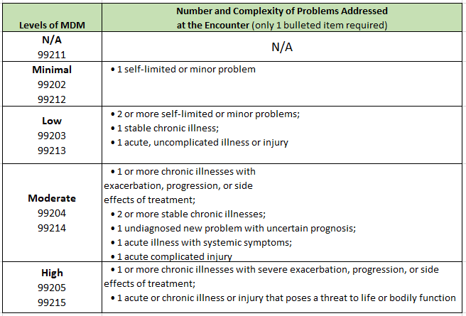
MDM: Element 1 - Number and Complexity of Problems Addressed

Slide 16
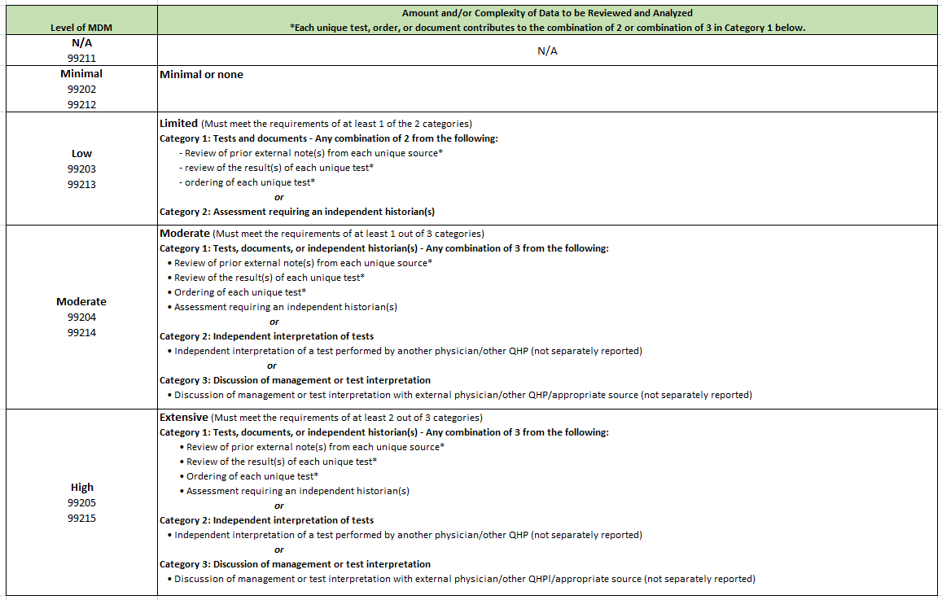
MDM: Element 2 - Amount and/or Complexity of Data to be Reviewed/Analyzed

Slide 17
MDM: Element 2 cont.
A note on Category 1 –Tests:
Per AMA, the actual performance, ordering, and/or interpretation of diagnostic tests/studies during a patient encounter are not counted in determining the level of E/M service when reported separately. In other words, if you perform/interpret a test and bill for that test, it cannot be counted towards MDM. Further, you cannot count the review/interpretation of the test on a subsequent day when the ordering of the test was counted towards MDM on a prior visit. Per CPT, the actual performance and/or interpretation of diagnostic tests/studies during a patient encounter are not included in determining the levels of E/M services when reported separately.
It is assumed that the physician or other QHP would review the results of the test ordered; therefore, the physician or other QHP would not receive dual credit toward MDM for both ordering and reviewing the test. Ordering and reviewing a test are considered a single component for MDM on the date of the encounter, even if ordering the test and subsequent review are performed on different days.

Slide 18
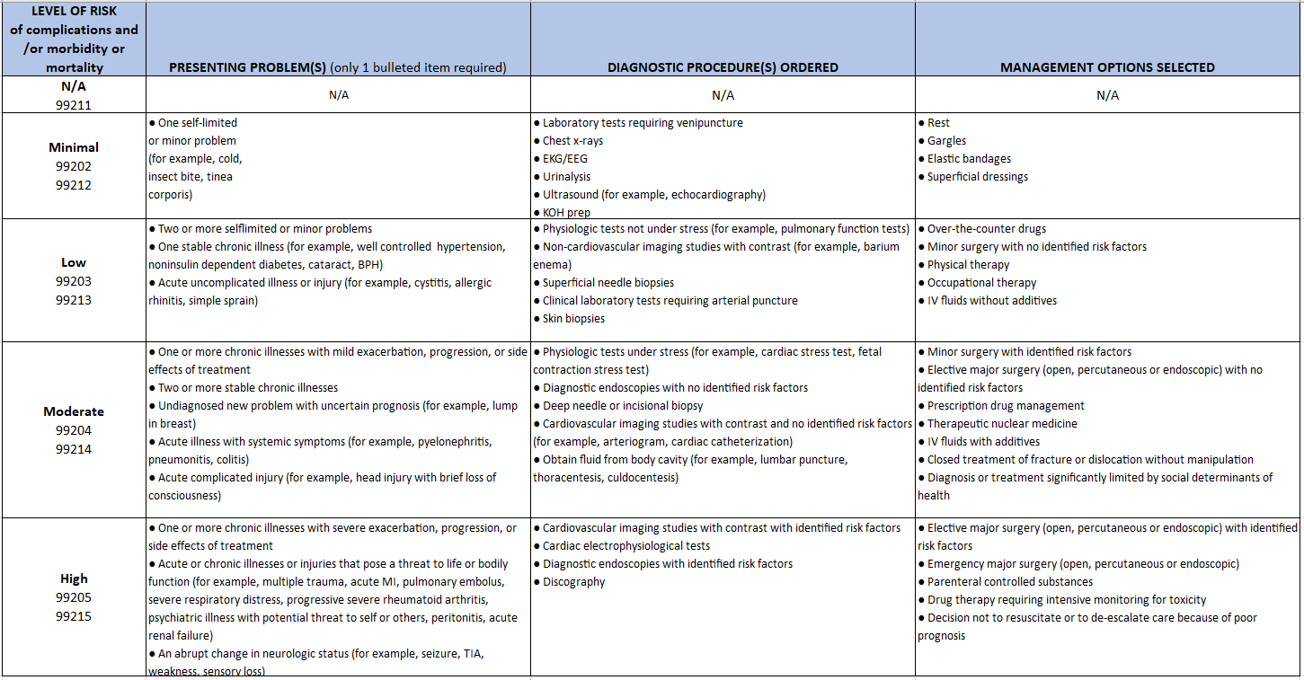
MDM: Element 3 - Risk of complications and/or morbidity or mortality of patient management (diagnostic testing or treatment)

Slide 19
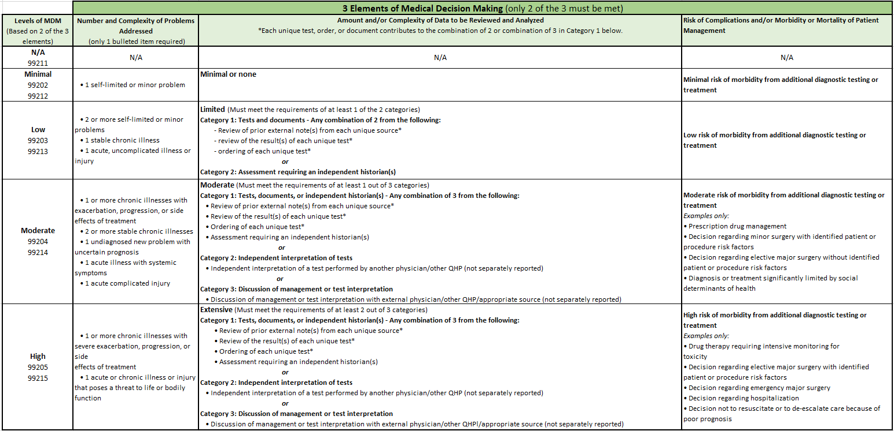
MDM - Putting it all together…

Slide 20
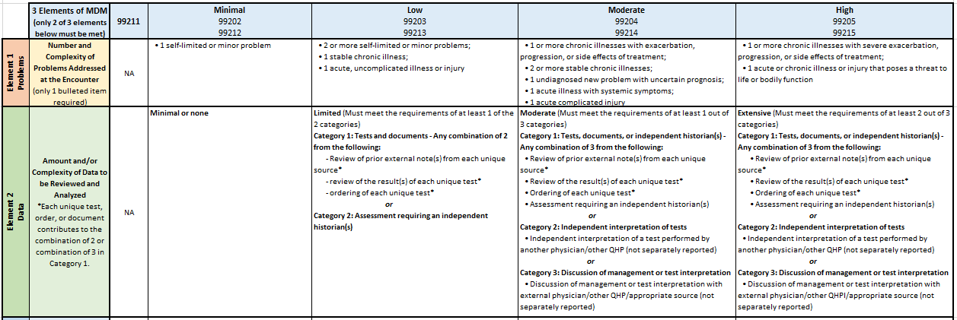
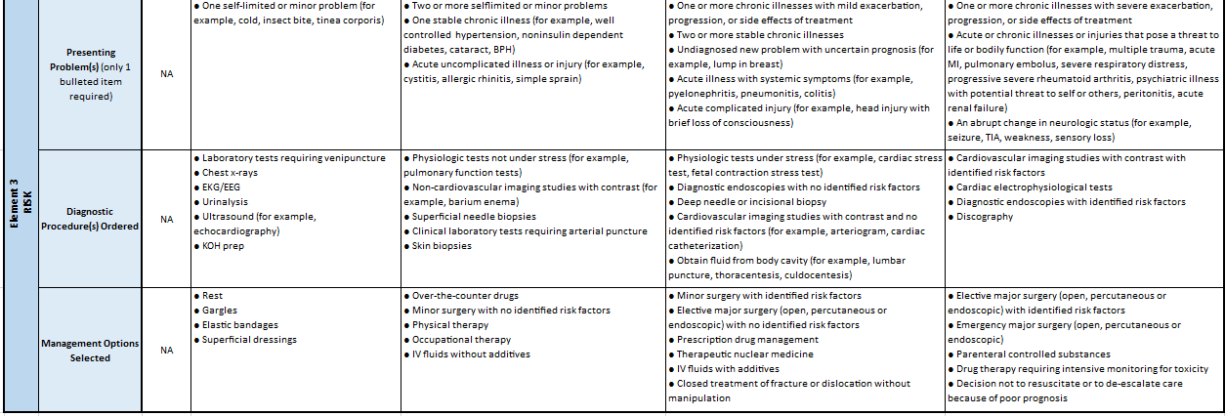
MDM Score Sheet (https://www.hcms.org/TMAIMIS/HARRIS/assets/PRACTICE_RESOURCES/Billing-Payers/2021_E_and_M_Coding_and_Documentation_Score_Sheet.pdf)
Circle the items in each row
that apply to the encounter. To
qualify for a particular level of
MDM, you must meet or exceed
at least two of the three elements
for that level of MDM (concept
unchanged from current
guidelines).
Example: 99203/99213 is the
appropriate code level to select
because it is the highest level
code where 2 of the 3 elements
of MDM have been
met/exceeded.

Slide 21
2023 Revisions
Finalized changes for Other E/M visits that parallel the changes made in 2021 for office/outpatient E/M visit coding and payment.
Applies to:
Hospital Inpatient (99221-99223)
Observation (99231-99239)
Consultations (99242-99245, 99252-99255)
Emergency Dept. (99281-99285)
Nursing Facility (99304-99310, 99315, 99316)
Domiciliary
Rest Home (eg, Boarding Home)
Custodial Care

Slide 22
2023 Revisions cont.
Adopted the revised CPT codes for Other E/M visits (except for prolonged services). This includes:
Merger of hospital inpatient and observation visits into a single code set, and merger of domiciliary, rest home (for example, boarding home), or custodial care and home visits into a single code set.
Choice of medical decision making or time to select visit level (except for visits that aren’t timed, such as emergency department visits).
For Other E/M Services (Hospital Observation, Hospital Inpatient, Consultations, Emergency Department, Nursing Facility, Domiciliary, Rest Home or Custodial Care, Home) time may only be used for selecting the level of the E/M services when counseling and/or coordination of care dominates the service.
Eliminated use of history and exam to decide visit level (document history or exam or both as appropriate).
New descriptor times (where relevant).
Revised CPT E/M guidelines for levels of medical decision making.
For Medicare, specific coding for prolonged Other E/M services and creation of 3 new G codes (one per E/M family):
G0316 for prolonged hospital inpatient or observation services
G0317 for prolonged nursing facility services
G0318 for prolonged home or residence services

Slide 23
2023 Revisions - Inpatient and Observation Care
Deletion of observation CPT codes (99217-99220, 99224-99226) and merged into the existing hospital care CPT codes (99221-99233, 99238-99239).
Editorial revisions to the code descriptors to reflect the structure of total time on the date of the encounter or level of medical decision-making when selecting code level.
Retention of revised Observation or Inpatient Care Services (Including Admission and Discharge Services) (99234-99236).
Revision of guidelines.
New prolonged services add-on code 99418 (use G0316 for Medicare).

Slide 24
2023 Revisions - Consultations
Retention of the consultation codes, with minor, editorial revision to the code descriptors.
Deletion of confusing guidelines, including the definition of “transfer of care."
Deletion of lowest level consultation codes, 99241 (office) and 99251 (inpatient), to align with four levels of MDM.

Slide 25
2023 Revisions - Emergency Dept.
Maintained the existing principle that time cannot be used as a key criterion for code level selection.
Editorial revisions to the code descriptors to reflect the code structure approved in the office visit revisions.
Modified MDM levels to align with office visits and maintain unique MDM levels for each visit.
Existing CPT code numbers maintained (analogous to office visit revisions).
Articulated current practice that was not explicit in the CPT code set.
May be used by physicians and QHPs other than just the ED staff.
Critical care may be reported in addition to ED service for clinical change.

Slide 26
2023 Revisions - Nursing Facility
Editorial revisions to the code descriptors to reflect the new standard E/M code structure.
Revision to nursing facility guidelines with new “problem addressed” definition of “multiple morbidities requiring intensive management,” to be considered at the high level for initial nursing facility care.
Deletion of code 99318 (annual nursing facility assessment). This existing service will be reported through the subsequent nursing facility care services (99307-99310) or Medicare G codes.
Not all “initial care” codes are the mandated comprehensive “admission assessment” and may be used by consultants.
Use subsequent visit when the principal physician’s team member performs care before the required comprehensive assessment.

Slide 27
2023 Revisions - Home and Residence
Editorial revisions to the code descriptors to reflect the new standard E/M code structure.
The domiciliary, rest home, or custodial care CPT codes (99324-99328, 99334-99337, 99339, 99340) were deleted and merged with the existing home visit CPT codes (99341-99350).
Elimination of duplicate MDM Level New Patient code (99343).

Slide 28
2023 Revisions - Prolonged Services
Deletion of direct patient contact prolonged service codes (99354-99357). These services will now be reported through either:
99417 for office or other outpatient setting or home/residence
G2212* for Medicare
99418 for inpatient, observation, and nursing facility. For Medicare use:
G0316* for inpatient and observation
G0317* for nursing facility.
G0318 for home or residence settings (Medicare only)
*Medicare utilizes different threshold times to bill for prolonged services (see table on next slide). Prolonged codes should only be billed after the total time for the primary service is exceeded plus an additional 15 minutes described by the prolonged code.

Slide 29
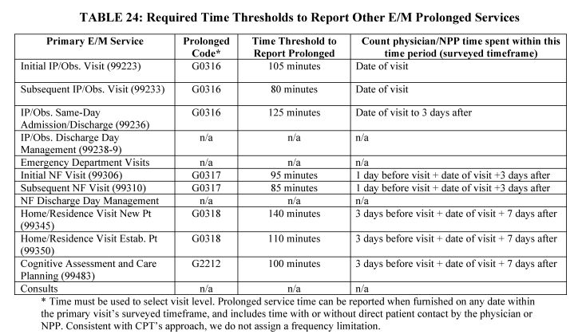
Prolonged Services - Medicare

Slide 30
E/M Documentation Resources
Resources:
2021:
AMA CPT® Evaluation and Management Office or Other Outpatient and Prolonged Services Code and Guideline Changes: https://bit.ly/3v1Tk8z
AMA Power Point presentation: https://bit.ly/3kWYAEd
CMS PFS Final Rule: https://www.federalregister.gov/documents/2020/12/28/2020-26815/medicare-program-cy-2021-payment-policies-under-the-physician-fee-schedule-and-other-changes-to-part
2023:
AMA CPT® Evaluation and Management (E/M) Code and Guideline Changes: https://www.ama-assn.org/system/files/2023-e-m-descriptors-guidelines.pdf
CMS PFS Final Rule: https://www.federalregister.gov/documents/2022/11/18/2022-23873/medicare-and-medicaid-programs-cy-2023-payment-policies-under-the-physician-fee-schedule-and-other

Slide 31
Payment and Practice Help
HCMS has been providing payment assistance and working to resolve payer-related issues for many years. Since the inception of the Payment and Practice Help and Medicare Quality Reporting Assistance program in 2000, HCMS has collected more than $30,000,000 in improperly paid claims, free of charge, for our physician members. For assistance contact us at 713-524-4267 or paymentadvocacy@hcms.org

