Slide 1
Evaluation & Management Coding and Documentation
A comprehensive guide to the 2021, 2023, and 2024 E/M revisions
in evaluation and management services, with detailed instructions on coding and documentation requirements for outpatient and inpatient evaluation and management services.
Please note that the content provided herein is informational only, and should NOT be considered legal, professional, business, practice, insurance, or other advice. Consult CPT instructions and individual payer rules for variations. This information is subject to change and should be verified from time to time.

Slide 2
2021, 2023, and 2024 E/M Revisions
This guide outlines the many of the revisions to evaluation and management (E/M) services and provides detailed information regarding the new E/M coding and documentation requirements.
The largest overhaul to the coding and documentation requirements for E/M services was undertaken in 2021 (for office visit E/M codes) and 2023 (for other outpatient/inpatient E/M codes). These changes were designed to simplify code selection and allow physicians to spend less time documenting their work and more time caring for patients. Revisions were made to E/M code descriptions, service level elements, time thresholds, and documentation requirements.
In 2021, the most significant revision was the elimination of the history, exam, and review of systems (ROS) as components for code selection. E/M code selection is now based solely on medical decision making (MDM) or total time. While the history, exam, and ROS are no longer elements counted towards the level of service, they are still to be documented if medically necessary. In addition, code 99201 was deleted.
In 2023, the 2021 revisions were applied to most other E/M services for consistency among the E/M code sets.
Revisions were also made during this time to prolonged services. Note that Medicare utilizes different codes sets threshold times and this guide includes these code sets for clarity.

Slide 3
2021 Summary of Revisions - 99201-99215
Eliminated history and physical as elements for code selection: These elements are no longer to be considered/counted in selecting the appropriate code levels for 99202-99215.
Allowed physicians to choose documentation based on Medical Decision Making (MDM) or Total Time:
MDM: The Workgroup did not materially change the three current MDM sub-components but did provide extensive edits to the elements for code selection and revised/created numerous clarifying definitions in the E/M guidelines.
Time: The definition of time is a minimum time, not typical time, and represents total physician/qualified health care professional (QHP) time on the date of service. These definitions only apply when code selection is based on time as opposed to MDM.
Modified the criteria for MDM:
Removed ambiguous terms (e.g. “mild”) and defined previously ambiguous concepts (e.g. “acute or chronic illness with systemic symptoms”).
Defined important terms, such as “independent historian.”
Re-defined the data elements to move away from simply adding up tasks to focusing on tasks that affect the management of the patient (e.g. independent interpretation of a test performed by another provider and/or discussion of test interpretation with an external physician/QHP).
Deleted CPT code 99201: As 99201 and 99202 are both straightforward MDM and only differentiated by history and exam elements which are no longer used for code selection, 99201 was eliminated.
Created a shorter prolonged services code: A shorter prolonged services code was created that would capture physician/QHP time in 15-minute increments, only to be reported with 99205 and 99215 when time is the basis for code selection.

Slide 4
2023 Summary of Revisions - Other E/M services
The revisions to Other Outpatient E/M Services parallel the changes made in 2021 for Office/Outpatient E/M visit code selection and documentation. Time thresholds were modified for some codes, while some code sets were deleted altogether, and others were deleted and merged into other code sets. The 2023 revisions applied to:
Hospital Inpatient
Observation
Consultations
Emergency Department
Nursing Facility
Domiciliary
Rest Home (e.g., Boarding Home),
Custodial Care

Slide 5
2023 Summary of Revisions - Other E/M services
Inpatient and Observation Care:
Deleted observation CPT codes (99217-99220, 99224-99226) and merged into the existing hospital care CPT codes (99221-99233, 99238-99239).
Revised code descriptors to reflect the structure of total time on the date of the encounter or level of MDM when selecting code levels.
Consultations:
Retained the consultation codes, with minor, editorial revision to the code descriptors.
Deleted confusing guidelines, including the definition of “transfer of care."
Deleted lowest level consultation codes, 99241 (office) and 99251 (inpatient), to align with four levels of MDM.

Slide 6
2023 Summary of Revisions - Other E/M services
Emergency Department:
Maintained that time cannot be used as a key criterion for code level selection.
Revised code descriptors to reflect the code structure in the office visit revisions.
Modified MDM levels to align with office visits and maintain unique MDM levels for each visit.
Articulated current practice that was not explicit in the CPT code set that may be used by physicians and QHPs other than just the ED staff.
Allowed critical care to be reported in addition to ED services for clinical change.
Home and Residence:
Revised the code descriptors to reflect the new E/M code structure.
Deleted the domiciliary, rest home, or custodial care codes 99324-99328, 99334-99337, 99339, 99340 and merged with the existing home visit codes 99341-99350.
Deleted 99343.

Slide 7
2023 Summary of Revisions - Other E/M services
Nursing Facility:
Made editorial revisions to the code descriptors to reflect the new E/M code structure.
Revised nursing facility guidelines with new “problem addressed” definition of “multiple morbidities requiring intensive management,” to be considered at the high level for initial nursing facility care.
Deleted code 99318 (annual nursing facility assessment). Report this service with the subsequent nursing facility care services (99307-99310) or Medicare G-codes.
Clarified not all “initial care” codes are the mandated comprehensive “admission assessment” and may be used by consultants.
Allowed the use subsequent visit codes when the principal physician’s team member performs care before the required comprehensive assessment.

Slide 8
E/M Code Selection – Time or MDM
The following slides outline coding and documentation requirements for E/M services using time or MDM for code selection and the requirements for billing for prolonged services.

Slide 9
Time - Documentation and Code Selection
The rules regarding code selection for E/M Office and Other Outpatient E/M Services were revised, as have some of the times associated with them. Certain categories of time-based E/M codes that do not have levels of services based on MDM (eg, Critical Care Services) in the E/M section use time differently. It is important to review the instructions for each category. For codes where time is not a descriptive element (ER Dept.), use MDM for code selection.
Also, the requirement that counseling and/or coordination of care dominate (greater than 50% of the time) the encounter has been eliminated. Each service that may be reported using time for code level selection has a required time threshold. The concept of attaining a mid-point between levels does not apply.
The time defined in the E/M code descriptors are used for selecting the appropriate level of services. The E/M services for which these guidelines apply require a face-to-face encounter with the physician or other qualified health care professional (QHP) and the patient and/or family/caregiver. The time that is counted is all the time on the date of the encounter only, including time spent before and after the encounter regardless of the location of the physician or other QHP (e.g. whether on or off the inpatient unit or in or out of the outpatient office). It does not include any time spent in the performance of other separately billed services.

Slide 10
Time - Documentation and Code Selection
Physician and other qualified health care professional (QHP) time includes the following activities (only the reporting clinician’s time can be counted).
▪ preparing to see the patient (review of tests, etc.)
▪ obtaining and/or reviewing separately obtained history
▪ performing a medically appropriate examination and/or evaluation
▪ counseling and educating the patient/family/caregiver
▪ ordering medications, tests, or procedures
▪ referring and communicating with other health care professionals (when not separately reported)
▪ documenting clinical information in the electronic or other health record
▪ independently interpreting results (not separately reported) and communicating results to the patient/family/caregiver
▪ care coordination (not separately reported)

Slide 11
Time - Documentation and Code Selection (cont.)
Document and count the following:
Include both face to face and non face to face time on the date of the encounter only.
Include only the reporting clinician’s time. Do not include time spent by clinical staff.
Document assessment and plan.
Document actual time spent precisely. Do not document a time range.
Document start and stop times if necessary.
Do not document time for services billed separately.
Only distinct time should be summed for shared or split visits (i.e., when two or more individuals jointly meet with or discuss the patient, only the time of one individual should be counted)

Slide 12
Time - Documentation and Code Selection (cont.)
Time thresholds for office visits:

Slide 13
Medical Decision Making - Documentation and Code Selection
The second option for selecting a level of E/M service is MDM. MDM includes establishing diagnoses, assessing the status of a condition, and/or selecting a management. Within each category or subcategory of E/M service based on MDM or time, there are three to five levels of E/M services available for reporting purposes. Levels of E/M services are not interchangeable among the different categories or subcategories of service. Examples in the following tables may be more or less applicable to specific care settings.
MDM in the office and other outpatient services code set is defined by:
4 levels of MDM - straightforward, low, moderate, and high.
3 elements of MDM:
number and complexity of problem(s) that are addressed during the encounter
amount and/or complexity of data to be reviewed and analyzed
risk of complications, morbidity, and/or mortality of patient management decisions made at the visit
The extent of history and physical examination is no longer an element in selection of codes 99202-99215. It is to be documented as medically necessary/appropriate.

Slide 14
Medical Decision Making – 3 Elements
3 elements of MDM :
1. The number and complexity of problem(s) that are addressed during the encounter.
2. The amount and/or complexity of data to be reviewed and analyzed including medical records, tests, and/or other information that must be obtained, ordered, reviewed, and analyzed for the encounter. This includes information obtained from multiple sources or interprofessional communications and interpretation of tests that are not separately reported. Ordering a test is included in the category of test result(s) and the review of the test result is part of the encounter and not a subsequent encounter. Data is divided into three categories:
Tests, documents, orders, or independent historian(s). (Each unique test, order or document is counted to meet a threshold number)
Independent interpretation of tests.
Discussion of management or test interpretation with external physician or other qualified healthcare professional or appropriate source
3. The risk (4 levels) of complications, morbidity, and/or mortality of patient management decisions made at the visit, associated with the patient’s problem(s), the diagnostic procedure(s), treatment (s). This includes the possible management options selected and those considered, but not selected, after shared MDM with the patient and/or family. For example, a decision about hospitalization includes consideration of alternative levels of care. There are 4 levels of risk.
To qualify for a particular level of MDM, two of the three elements for that level of decision making must be met or exceeded.

Slide 15
MDM: Element 1 - Number and Complexity of Problems Addressed

Slide 16
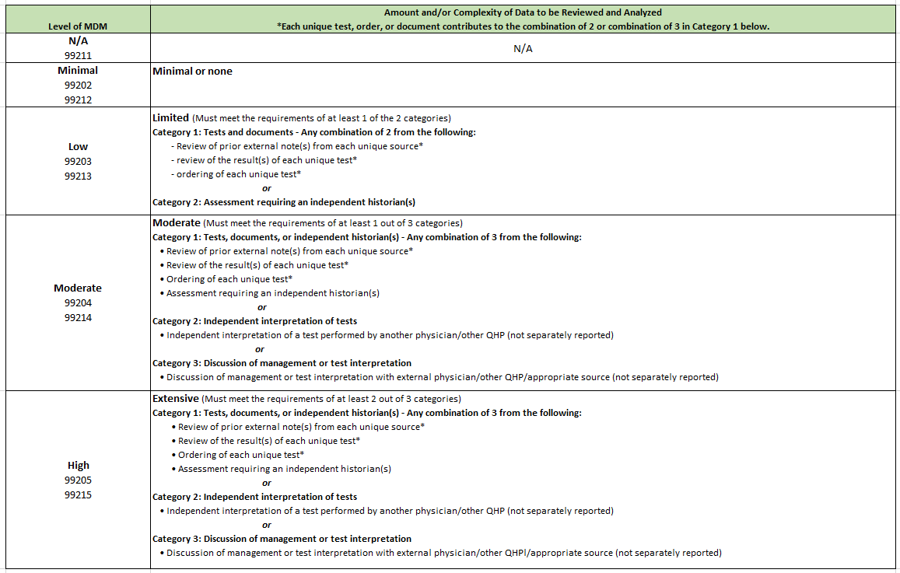
MDM: Element 2 - Amount and/or Complexity of Data to be Reviewed/Analyzed

Slide 17
MDM: Element 2 (cont.)
A note on Category 1 –Tests:
Per AMA, the actual performance, ordering, and/or interpretation of diagnostic tests/studies during a patient encounter are not counted in determining the level of E/M service when reported separately. In other words, if you perform/interpret a test and bill for that test, it cannot be counted towards MDM. Further, you cannot count the review/interpretation of the test on a subsequent day when the ordering of the test was counted towards MDM on a prior visit. Per CPT, the actual performance and/or interpretation of diagnostic tests/studies during a patient encounter are not included in determining the levels of E/M services when reported separately.
It is assumed that the physician or other QHP would review the results of the test ordered; therefore, the physician or other QHP would not receive dual credit toward MDM for both ordering and reviewing the test. Ordering and reviewing a test are considered a single component for MDM on the date of the encounter, even if ordering the test and subsequent review are performed on different days.

Slide 18
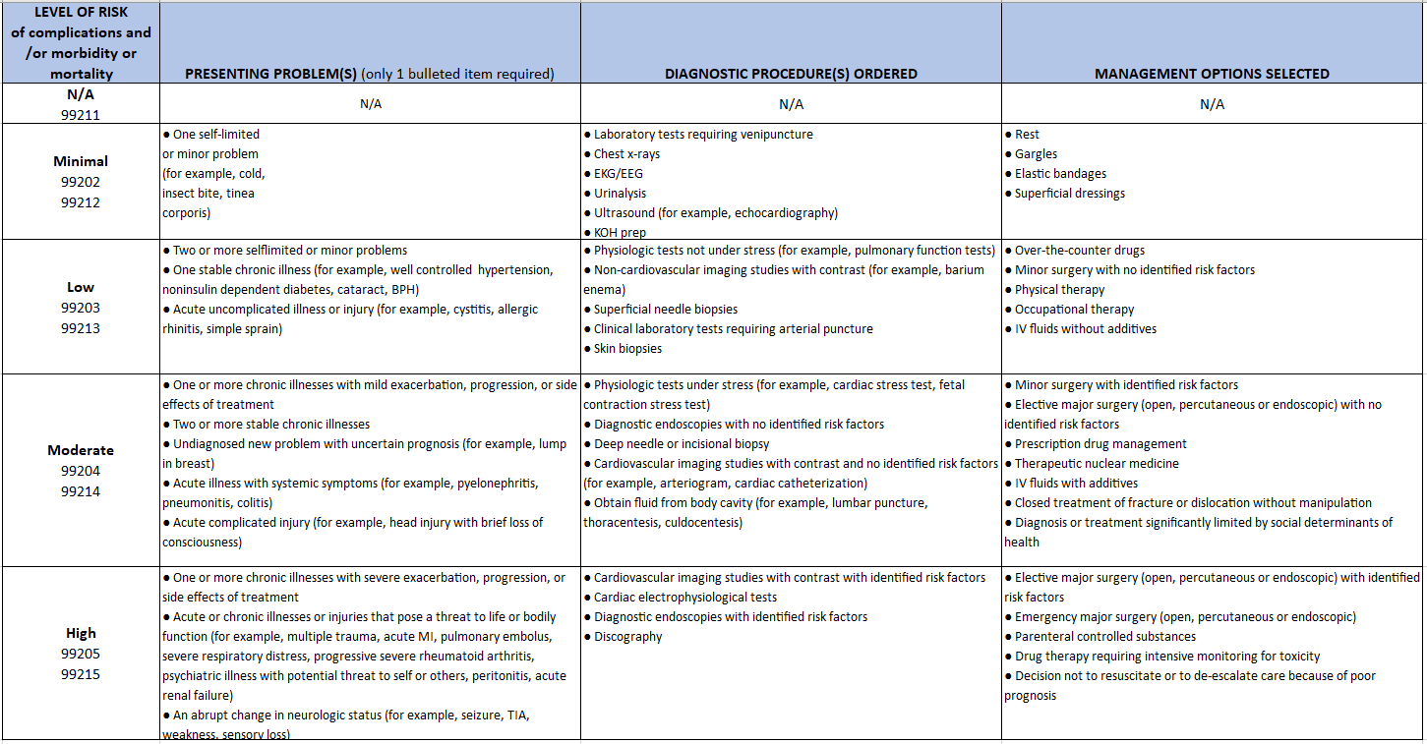
MDM: Element 3 - Risk of complications and/or morbidity or mortality of patient management (diagnostic testing or treatment)

Slide 19
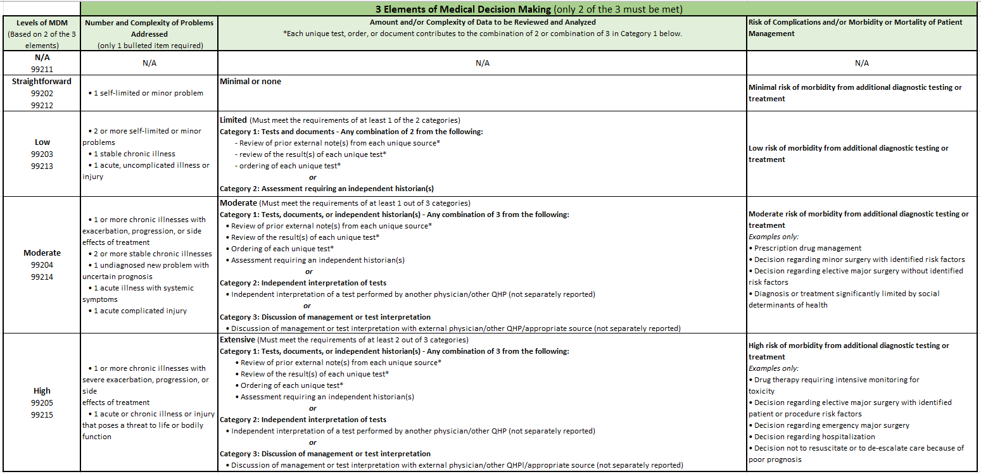
MDM - Putting it all together…

Slide 20
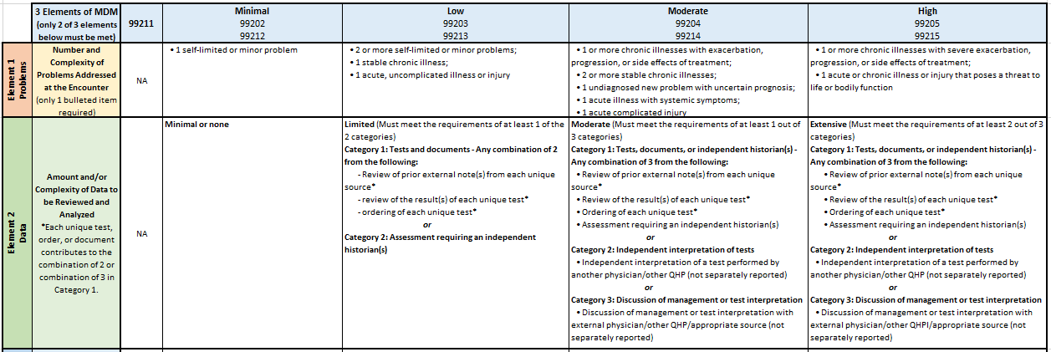
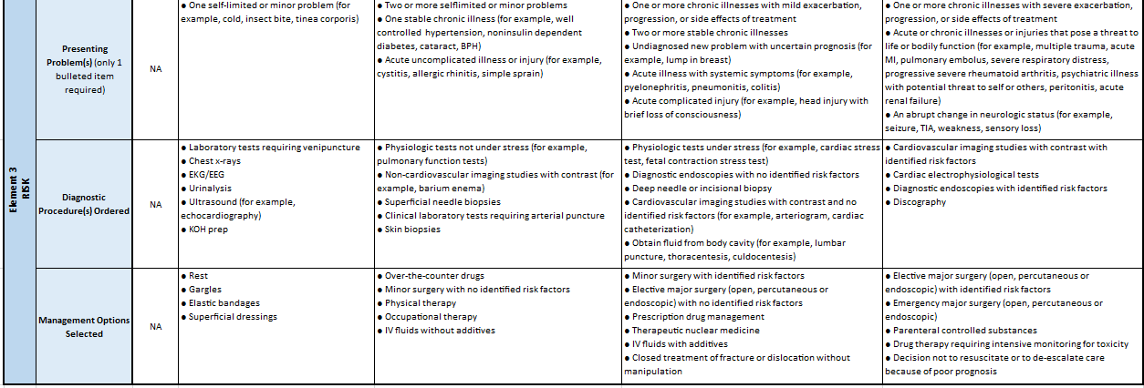
MDM Score Sheet (https://www.hcms.org/TMAIMIS/HARRIS/assets/PRACTICE_RESOURCES/Billing-Payers/2021_E_and_M_Coding_and_Documentation_Score_Sheet.pdf)
Circle the items in each row
that apply to the encounter. To
qualify for a particular level of
MDM, you must meet or exceed
at least two of the three elements
for that level of MDM (concept
unchanged from current
guidelines).
Example: 99203/99213 is the
appropriate code level to select
because it is the highest level
code where 2 of the 3 elements
of MDM have been
met/exceeded.

Slide 21
Prolonged Services Summary
Prolonged services codes are add-on codes to evaluation and management (E/M) services and are used when a physician or other qualified healthcare professional spends more time with a patient than the time allotted to the E/M code. Prolonged services codes have gone through a series of changes and have been revised as to time thresholds, addition and deletion of codes, and definition amendments.
Medicare does not recognize many of the revisions and thus has separate code sets, definitions, and billing conventions (see slides 13-21).

Slide 22
Prolonged Services Summary
Commercial/Medicaid
99415 - Prolonged clinical staff services (with physician or other qualified health care professional supervision)
99416 - Each additional 30 minutes.
99417 - Prolonged outpatient E/M service with or without direct patient contact on the date of an office or other outpatient service
99418 - Prolonged inpatient or observation E/M service with or without direct patient contact
99358 - Prolonged service without direct patient contact on date other than the face-to-face E/M service
99359 - Each additional 30 minutes
Medicare/Medicare Advantage
G2212 - Prolonged office or other outpatient evaluation and management service(s)
G0513: Prolonged preventive service; first 30 minutes
G0514: Each additional 30 minutes
G0316 – Prolonged Hospital Inpatient or Observation Services
G0317 - Prolonged nursing facility E/M services
G0318 - Prolonged home or residence E/M services
99415 - Prolonged clinical staff services (with physician or other qualified health care professional supervision)
99416 - Each additional 30 minutes.

Slide 23
Prolonged Services Documentation
Thorough documentation is important to avoid denials and potential audits.
Documentation must be appropriately and sufficiently documented to show the total time of the service and that they personally provided the service.
Example: “I personally spent ____ minutes including pre and post visit work (when applicable to the code billed).”
Documentation must support or easily infer how the time was spent. Describe the specific activities performed during the additional time.
“I spoke to cardiology …”
“I received the past medical chart the patient brought with him from Florida.”
“I spoke to the patients Social Worker at the group home about the need for a higher level of care …”
“I spoke at length today with Ms. Jones and her family about the prognosis and treatment options. I contacted the Finger Lakes infusion center to make sure they could schedule her on Fridays only.”
Documentation must include medically necessity for the prolonged service to explain why the service was prolonged, such as the patient's condition, counseling, or treatment planning.
Documentation must confirm that the additional time was spent under the direct supervision of the billing physician when performed by a non-physician.
Documentation must reference the primary face-to-face E/M service code with which the prolonged services are related and differentiate the prolonged service time from the E/M time if performed on a different day.

Slide 24
Prolonged Services 99415-99416
99415-99416 - Prolonged Clinical Staff Services With Physician or Other Qualified Health Care Professional Supervision
99415 - Prolonged clinical staff face-to-face time beyond the E/M service time in the office or outpatient setting (even if the time spent on that date is not continuous), with physician supervision; first hour.
Bill with E/M codes 99202-99205 and 99211-99215.
Do not bill with CPT 99417.
Use 99415 when the E/M code time threshold has been surpassed by 30 minutes.
Do not count time spent on other services that are being separately billed.
99416 - Each additional 30 minutes (list in addition to 99415).
99416 may be used to report the final 15-30 minutes of prolonged service. Prolonged service of less than 15 minutes beyond the first hour (99415) or less than 15 minutes beyond the final 30 minutes (99416) is not reported separately.
**99415-99416 may be used for Medicare/Medicare Advantage; not covered by Medicaid.

Slide 25
99415-99416 Timetable
The starting point for 99415 is 30 minutes beyond the typical clinical staff time for ongoing assessment of the patient during the office visit. The table provides the typical clinical staff times for the E/M codes, the range of time beyond the clinical staff time for which 99415 may be reported, and the starting point at which 99416 may be reported.

Slide 26
Prolonged Services 99417
99417 - Prolonged Outpatient E/M Service With or Without Direct Patient Contact on the Date of an Office or Other Outpatient Service
99417 – Prolonged outpatient E/M service time, with or without direct patient contact, beyond the required time of the highest level E/M service when the E/M code has been selected based on time; each 15 minutes.
Bill with 98003, 98007, 98011, 98015, 99205, 99215, 99245, 99345, 99350, 99483.
Do not count any additional time spent on a prior or subsequent date of service.
Do not count time spent on other services that are being separately billed.
Do not bill with 90833, 90836, 90838, 99358,99359, 99415, or 99416.
E/M code time threshold must have been surpassed by 15 minutes.
**May not be used for Medicare/Medicare Advantage (see G2212).

Slide 27
99417 Timetable and Examples
Timetable:
Billing Multiple Units:

Slide 28
Prolonged Services 99418
99418 - Prolonged Inpatient or Observation E/M Service With or Without Direct Patient Contact on the Date of an Office or Other Outpatient Service
99418 -Prolonged inpatient or observation evaluation and management service(s) time with or without direct patient contact beyond the required time of the highest level E/M service when the E/M code has been selected based on time; each 15 minutes of total time.
Bill with 99223, 99233, 99236, 99255, 99306, 99310.
Do not bill with 90833, 90836, 90838, 99358,99359, 99415, or 99416.
Use when the E/M code time threshold has been surpassed by 15 minutes.

Slide 29
Prolonged Services 99358-99359
99358-99359 - Prolonged Service Without Direct Patient Contact on Date Other Than the Face-to-Face Evaluation and Management Service
Codes 99358 and 99359 are used when a prolonged service is provided that is neither face-to-face time in the outpatient, inpatient, or observation setting, nor additional unit/floor time in the hospital or nursing facility setting and must be reported on a date other than the face-to-face service to which it is related even if the time spent on that date is not continuous. Codes 99358, 99359 may be used during the same session of an E/M service, except office or other outpatient services (99202, 99203, 99204, 99205, 99211, 99212, 99213, 99214, 99215).
99358 - Prolonged evaluation and management service before and/or after direct patient care; first hour
Do not report 99358, 99359 on the same date of service as 99417.
Do not report 99358, 99359 during the same month with 99484, 99487-99489, 99490, 99491, 99492, 99493, 99494.
Do not report 99358, 99359 when performed during the service time of codes 99495 or 99496, if reporting 99495 or 99496.
May be reported for prolonged services in relation to any evaluation and management service at any level on a date other than the face-to-face service, whether or not time was used to select the level of the face-to-face service.
Do not count time spent on other services that are being separately billed.
May be used when the E/M code time threshold has been surpassed by 30 minutes.
99359 - Each additional 30 minutes beyond the first hour (99358).
May be used to report the final 15 to 30 minutes of prolonged service on a given date.

Slide 30
99358-99359 Timetable Example

Slide 31
E/M Time Thresholds

Slide 32
Medicare Prolonged Services
Guidelines, Definitions, and Billing Requirements

Slide 33
Medicare Prolonged Services G2212-G0514
CMS created HCPCS codes when billing Medicare for prolonged Evaluation and Management (E/M) services which exceeds the maximum time for the highest level E/M code in each category by at least 15 minutes on the date of service. CMS prolonged service guidelines are different from CPT. Medicare Administrative Contractors (MACs) will process claims per the Internet Only Manual (IOM) Publication 100-04, Medicare Claims Processing Manual, Chapter 12, section 30.6.15.
G2212: Prolonged office or outpatient E/M services
G0513: Prolonged preventive service; first 30 minutes
G0514: Each additional 30 minutes
G0316: Prolonged hospital inpatient or observation care
G0317: Prolonged nursing facility E/M services
G0318: Prolonged home or residence E/M services
99415: - Prolonged clinical staff services (with physician or other qualified health care professional supervision)
99416: Each additional 30 minutes.

Slide 34
Prolonged Visits -Office or Other Outpatient - G2212
G2212 – Prolonged office or other outpatient E/M service(s) beyond the maximum required time of the highest level E/M code which has been selected based on time, with or without direct patient contact (Use in place of 99417); each additional 15 minutes .
Report with 99205, 99215, 99483.
Do not report on the same date of service as 99354, 99355, 99358, 99359, 99415, 99416.
Do not count time spent on other services that are being separately billed.

Slide 35
Prolonged Visits - Preventive Service - G0513-G0514
G0513 – Prolonged preventive service in the office or other outpatient setting requiring direct patient contact beyond the timeframe associated with the service (report with preventive service code; use in place of 99415); first 30 minutes.
G0514 - Each additional 30 minutes (Use in place of 99416).
Do not count time spent on other services that are being separately billed.
Timeframes for these services are as follows:

Slide 36
Prolonged Visits - Hospital Inpatient/Observation - G0316
G0316 - Prolonged hospital inpatient or observation care E/M service(s) beyond the maximum required time of the highest level E/M code which has been selected based on time, with or without direct patient contact; each additional 15 minutes.
Bill with 99223, 99233, and 99236.
Do not report on the same date of service as 99354, 99355, 99358, 99359, 99415, 99416.
Use in place of 99418.
Do not count time spent on other services that are being separately billed.
Count time spent performing qualifying activities when performed on any date within the surveyed timeframe for the visit

Slide 37
Prolonged Visits - Nursing Facility - G0317
G0317 - Prolonged nursing facility evaluation and management service(s) beyond the maximum required time of the highest level E/M code which has been selected based on time, with or without direct patient contact; each additional 15 minutes.
Bill with 99306, 99310.
Do not report on the same date of service as 99304, 99305, 99307, 99308, 99315 and 99316.
Do not count time spent on other services that are being separately billed.
Count time spent performing qualifying activities when performed on any date within the surveyed timeframe for the visit

Slide 38
Prolonged Visits - Home or Residence - G0318
G0318 - Prolonged home or residence evaluation and management service(s) beyond the maximum required time of the highest level E/M code which has been selected based on time, with or without direct patient contact; each additional 15 minutes.
Bill with 99345, 99350.
Do not report on the same date of service as 99358, 99359, or 99417.
Do not count time spent on other services that are being separately billed.
Count time spent performing qualifying activities when performed on any date within the surveyed timeframe for the visit

Slide 39
Prolonged Services 99415-99416
99415-99416 - Prolonged Clinical Staff Services With Physician or Other Qualified Health Care Professional Supervision
99415 - Prolonged clinical staff face-to-face time beyond the E/M service time in the office or outpatient setting (even if the time spent on that date is not continuous), with physician supervision; first hour.
Bill with E/M codes 99202-99205 and 99211-99215.
Do not bill with CPT 99417.
Use 99415 when the E/M code time threshold has been surpassed by 30 minutes.
Do not count time spent on other services that are being separately billed.
99416 - Each additional 30 minutes (list in addition to 99415).
99416 may be used to report the final 15-30 minutes of prolonged service. Prolonged service of less than 15 minutes beyond the first hour (99415) or less than 15 minutes beyond the final 30 minutes (99416) is not reported separately.

Slide 40
99415-99416 Timetable
The starting point for 99415 is 30 minutes beyond the typical clinical staff time for ongoing assessment of the patient during the office visit. The table provides the typical clinical staff times for the E/M codes, the range of time beyond the clinical staff time for which 99415 may be reported, and the starting point at which 99416 may be reported.

Slide 41
E/M Documentation Resources
Resources:
2021:
AMA CPT® Evaluation and Management Office or Other Outpatient and Prolonged Services Code and Guideline Changes: https://bit.ly/3v1Tk8z
AMA Power Point presentation: https://bit.ly/3kWYAEd
CMS PFS Final Rule: https://www.federalregister.gov/documents/2020/12/28/2020-26815/medicare-program-cy-2021-payment-policies-under-the-physician-fee-schedule-and-other-changes-to-part
2023:
AMA CPT® Evaluation and Management (E/M) Code and Guideline Changes: https://www.ama-assn.org/system/files/2023-e-m-descriptors-guidelines.pdf
CMS PFS Final Rule: https://www.federalregister.gov/documents/2022/11/18/2022-23873/medicare-and-medicaid-programs-cy-2023-payment-policies-under-the-physician-fee-schedule-and-other

Slide 42
Payment and Practice Help
HCMS has been providing successfully assistance with claims payment, payer policies, regulatory and practice management issues, and other concerns since 2000. For assistance contact the Payment and Practice Help and Medicare Quality Reporting Assistance program at 713-524-4267 or paymentadvocacy@hcms.org.

