Slide 1

The Business of Medicine
Health Insurance Basics
Harris County Medical Society (HCMS)
April A. Bellard, MHA
Director of Payment Advocacy and Practice Management

Slide 2
Business of Medicine
This presentation is in no way intended to provide particular advice on business decisions or legal matters.
The “business of medicine” in this presentation refers to all operations not including clinical activities.

Slide 3
Practice Settings
Employment
Group
Hospital
Academic
Health Plan
Independent Practice
Each setting has its own pros and cons. Regardless of the setting, health plans will impact how medicine is practiced.

Slide 4
Health Plan Types
Medicare (MCR) and Medicare Advantage Plans (MAPs)
Medicaid (MCD) and Managed Medicaid Plans (MCOs)
Commercial and Individual Marketplace Plans (ACA plans)
Other Governmental (VA, active and retired military, state and federal employer, etc.)

Slide 5
Health Plan Types
The agency responsible for overseeing compliance with state and/or federal regulations is determined by the plan type. It is imperative to understand the intricacies of each plan type, how each is governed, and how to navigate various processes (contracting, credentialing, complaints, etc.).
It is also important to understand the impact of health plan payment rates, policies, etc. on practice settings. Independent practice is directly affected while those that are employed are indirectly impacted. Regardless, health plans impact all practices that contract with health plans.

Slide 6
Traditional Medicare
Regulated federally by the Centers for Medicare & Medicaid Services (CMS) and administered via Medicare Administrative Contractors (MACs) (Novitas)
Includes Parts A (hospital/facility), B (physician services), and D (prescription drugs)
Complex enrollment process
Requires revalidation every 5 years
Requires participation in Quality Payment Programs (QPP)
Payment rates are low and trend downward over time.
Physician fee schedule subject to budget neutrality
Not adjusted for inflation
Insufficient to cover costs
Subject to sequestration, PAYGO, and QPP penalties

Slide 7
Medicare Physician Fee Calculation
The Medicare physician fee schedule is based on a resource-based relative value scale (RBRVS) standardizing physician payments based on resources needed to provide a service. Fees are calculated using three weighted RVUs and adjusted for geographical differences. Many commercial payers base their rates on RVUs.
RVUs - relative value units; assigns resources needed to perform a service.
Work (wRVU) (54%)
Practice Expenses (peRVU) (41%)
Malpractice Insurance (mpRVU) (5%)
GPCIs – geographical practice cost indices; accounts for geographic variations in resources/costs.
Conversion Factor – a value that converts the total RVUs into payment amounts.

Slide 8
Relative Value Units
wRVU: Accounts for the time, technical skill and effort, mental effort and judgment, and stress to provide a service.
peRVU: Accounts for the non-physician clinical and nonclinical labor, overhead, equipment and office supplies. There are different peRVUs for services provided in facility settings and in office settings.
mpRVU: Accounts for the cost of malpractice insurance premiums.

Slide 9
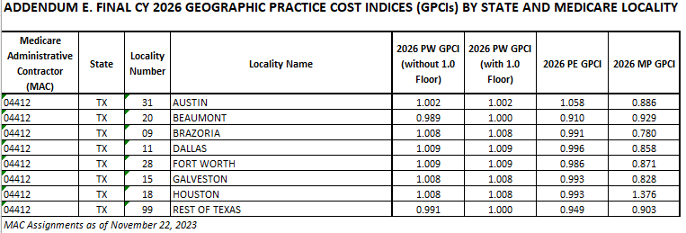
Geographic Practice Cost Indices (GPCIs)
There are currently 89 GPCIs that reflect the differences in relative costs associated with physician work, practice expenses, and medical liability insurance in each locality as compared to national average relative costs.

Slide 10
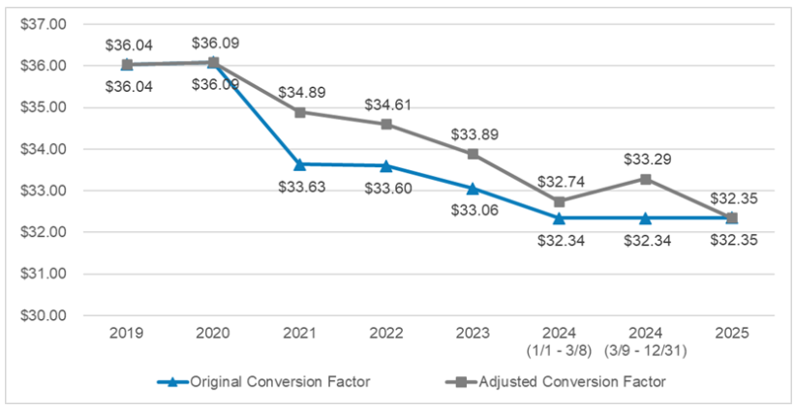
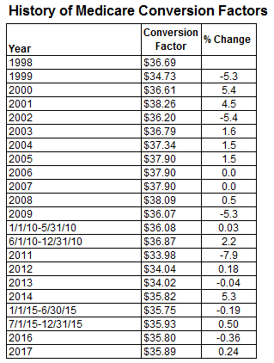
Conversion Factor (CF)

Slide 11
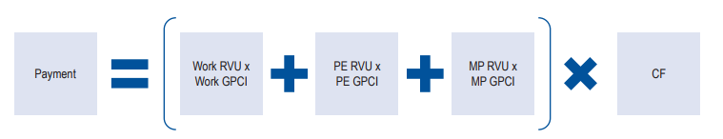
RVUs, GPCIs, and CFs Fee Calculation

Slide 12
Medicare Advantage Plans (MAPs)
Medicare Advantage Plans are offered by private companies that provide Parts A, B, and D coverage in one plan. These plans are also referred to as Part C. MAPs cover all Medicare services and often offer extra coverage like vision, hearing, and dental coverage.
Regulated by CMS
Generally utilize the Medicare physician fee sched.
May or may not apply sequestration reductions
Require prior authorizations and referrals
Have in-network and formulary restrictions

Slide 13
Medicaid and Medicaid Managed Care
Medicaid is a State (TMHP) and Federal cooperative venture for those at a specific poverty level. Most Medicaid in Texas is administered through Medicaid Managed Care Organizations (MCOs) under contract with the state. Currently, there are four such programs in Texas: STAR, STAR+PLUS, STAR Health, and STAR Kids that, for the most part, offer services through MCOs. These plans often offer additional services not covered by traditional Medicaid (dental, vision, etc.).
The Children's Health Insurance Program (CHIP) offers low-cost health coverage for children from birth through age 18. CHIP is designed for families who earn too much money to qualify for Medicaid but cannot afford to buy private health coverage. Like the above programs, these services are all administered by private MCOs with their own network of providers.

Slide 14
Medicaid and Medicaid Managed Care
Regulated by the Texas Health and Human Services with some federal oversight by the Centers for Medicare & Medicaid Services (CMS)
Administered via the Texas Medicaid & Healthcare Partnership (TMHP)
Complex and burdensome enrollment process
Requires revalidation every 3 years
Subject to annual audits often resulting in recoupments
State requires 50% of physician contracts to be value-based, 25% of which with downside financial risk.
Payment rates are very low (less than Medicare)
Reviewed every 2 years
Based on cost reports and Medicare Fee Schedule RVUs multiplied by a lower conversion factor
Not adjusted for inflation
Insufficient to cover costs
Example: Mid-level office visit 99213
MCR: $96.33 MCD: $33.95

Slide 15
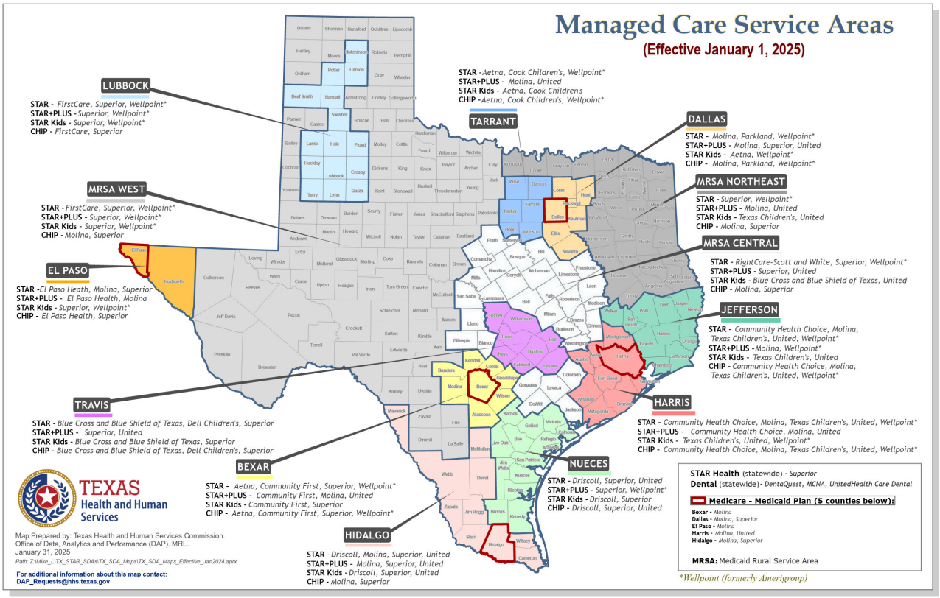
Medicaid Managed Care Service Areas

Slide 16
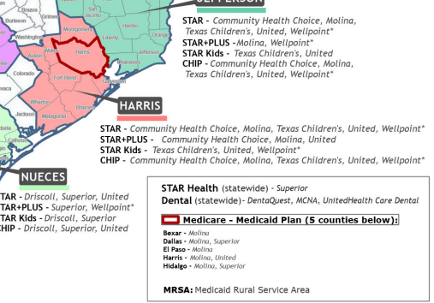
Harris County MCOs

Slide 17
Commercial Plans
Commercial plans consist of various group and individual plan types:
Employer-sponsored
Self-insured
Fully-insured
Marketplace (Obamacare/ACA plans)

Slide 18
Commercial Plans
The majority of working-aged individuals and their dependents are covered through one of the 5 major market commercial insurers. These insurers generally offer fully-insured, self-insured, Medicare Advantage, Medicaid, and Marketplace plans:
Aetna
BCBS/Anthem
Cigna
Humana
United Healthcare

Slide 19
Individual/Marketplace Plans
The Health Insurance Marketplace was developed as a result of the Affordable Care Act (ACA), which
is the comprehensive health care reform law enacted in March 2010. Individuals and small businesses can compare and purchase insurance through HealthCare.gov or state-based exchanges.
These plans are fully-insured and regulated by state departments of insurance.

Slide 20
Fully-Insured vs. Self-Insured
Fully-insured Plans:
These are traditional employer-sponsored plans where the employer pays a fixed premium to an insurer, and the insurer takes on all the financial risk, claims payment, administration, and regulatory compliance much like home and auto insurance products.
Account for only 33%-37% of the commercial market
Subject to large annual premium increases
Are regulated by the Texas Department of Insurance (TDI)
Are subject to Texas Prompt Pay Regulations
“TDI” or “DOI” will be printed on the patient’s ID card

Slide 21
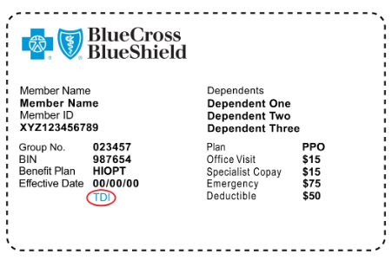
Fully-Insured vs. Self-Insured

Slide 22
Fully-Insured vs. Self-Insured
Self-insured Plans:
The employer is the insurer and assumes the financial risk of paying claims from company funds, and often purchases stop-loss coverage to handle catastrophic events. Employers who self-insure contract with an insurance company (third-party administrator or Management Services Org.) to administer the plan. These plans are not insurance products.
Account for 63%-67% of the commercial market
Not subject to large annual premium increases
Are not regulated by TDI but instead regulated under federal ERISA regulations
Are not subject to Texas Prompt Pay Regulations
“TDI” or “DOI” will not be printed on the patient’s ID card
The 5 major market insurers are now predominately in the business of administering these plans

Slide 23
Contact Information
April A. Bellard, MHA
Director of Payment Advocacy and Practice Management
Harris County Medical Society
1515 Hermann Dr., #203
Houston, TX 77004
Phone: 713-524-4267 ext. 203
Email: April_Bellard@hcms.org

